Slide 1
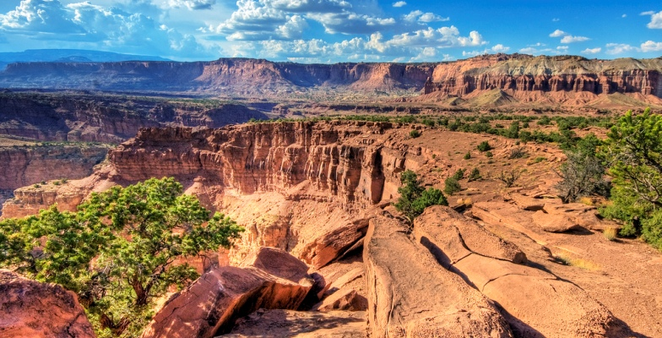
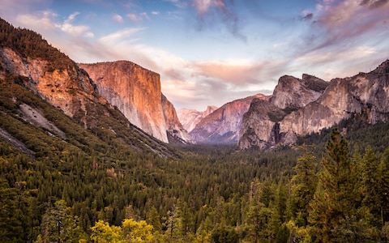
Which National Park should I go to?
Project #1 Web Scraping
July 22, 2019 Hyelee Lee

Slide 2
01
Motivation & Question
02
Web Scraping
Contents
03
Analysis
04
Summary & Future work

Slide 3

01
Motivation & Question
Why did I choose National Park?
Question
Q1. Where is Top10 National Park popular in the United States?
Q2. When is a good time to go to the national park?
Q3. How much is the admission fee to a popular national park?? Does it have to do with the entrance fee and the number of visitors?

Slide 4

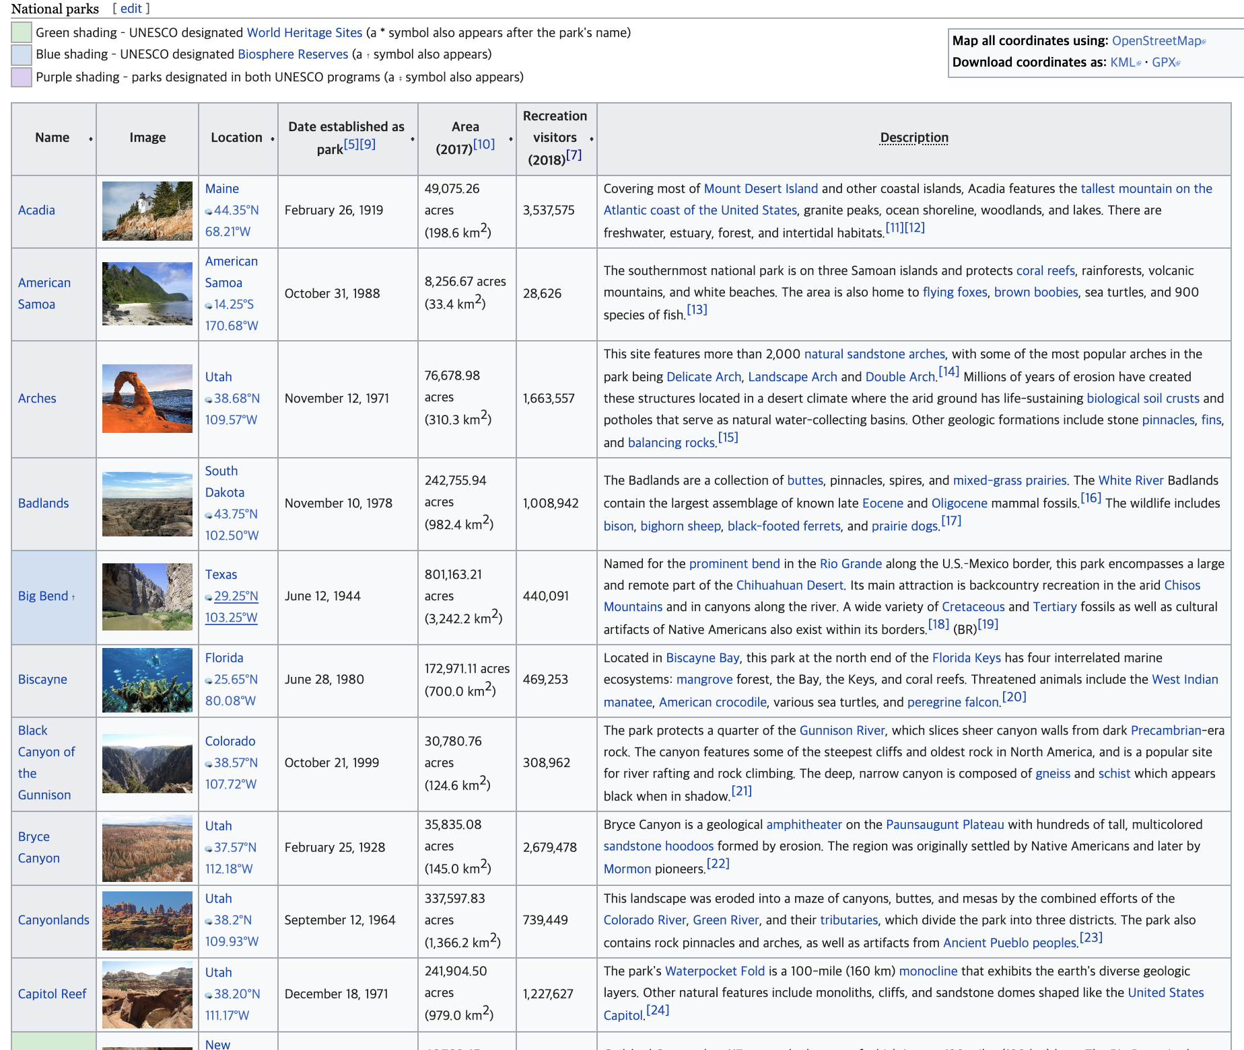

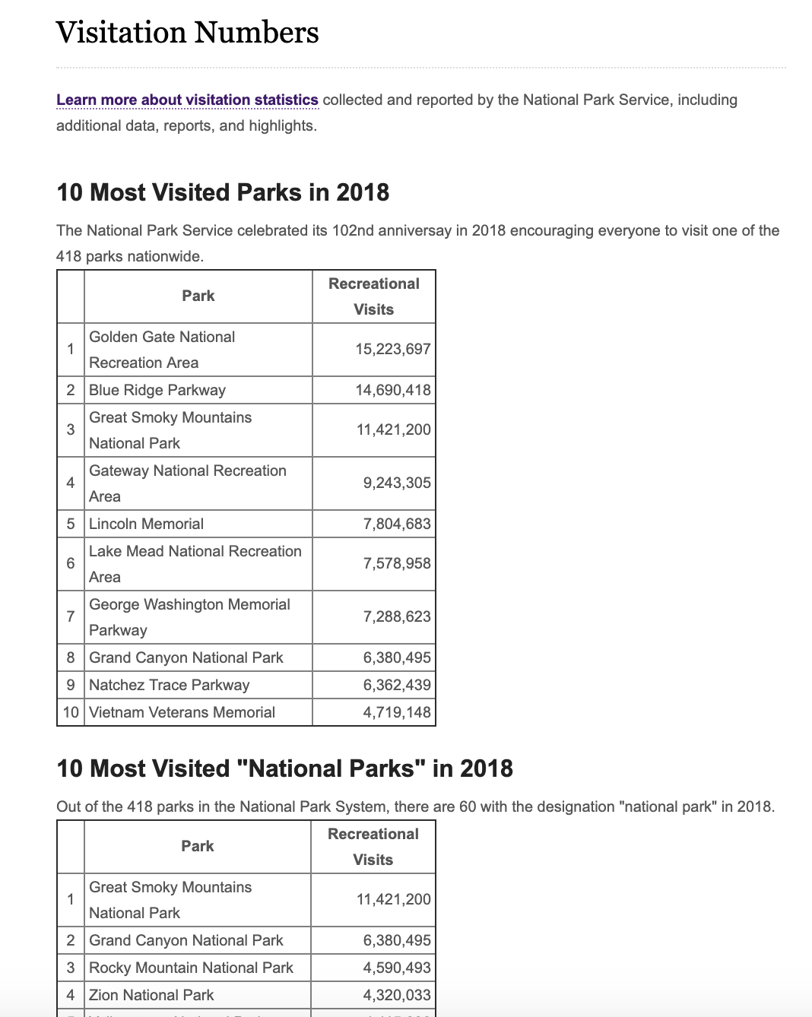
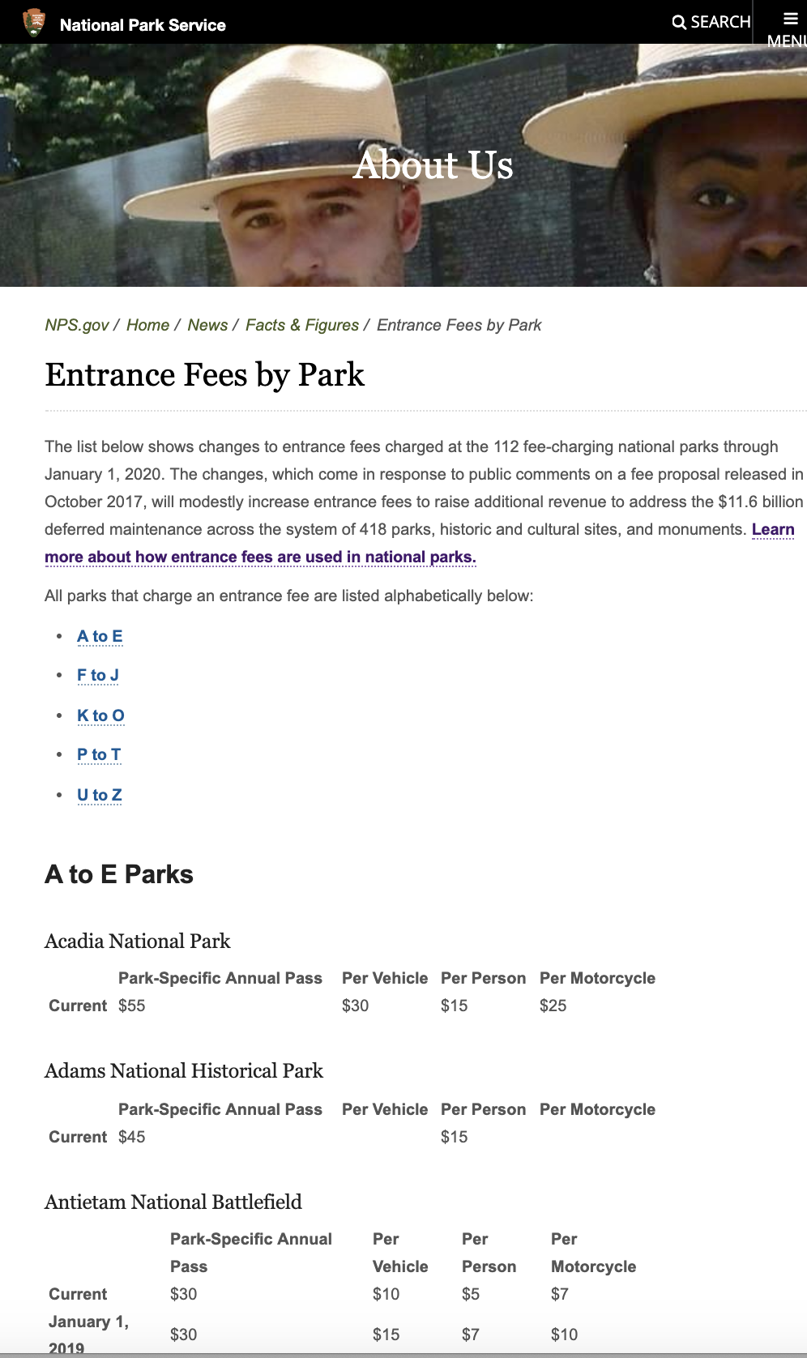

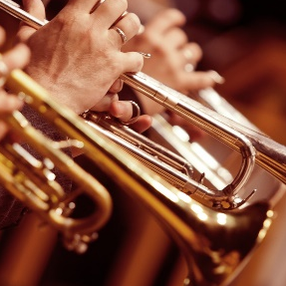
02
Web Scraping
TRUMPET

Slide 5
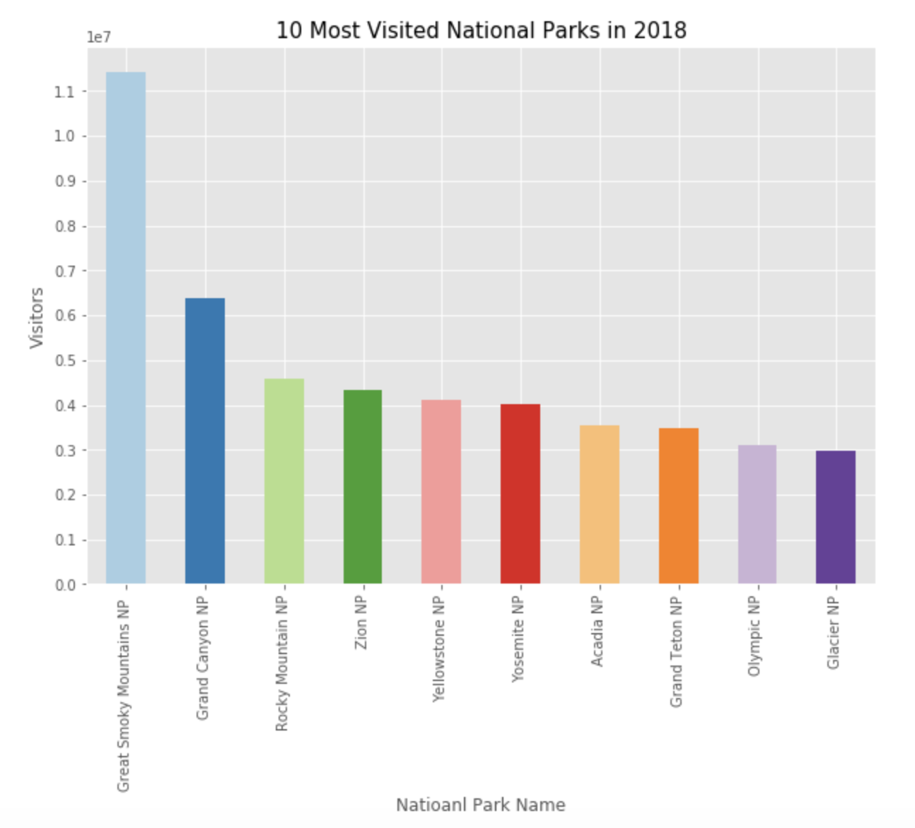
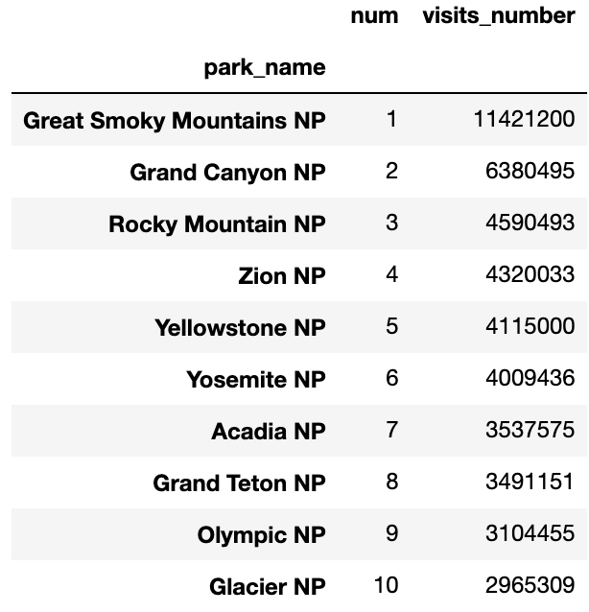
03
Analysis – Q1.
Where is Top10 National Park popular in the United States?
이 곳에 내용을 입력해주세요. 이 곳에 내용을 입력해주세요.

Slide 6
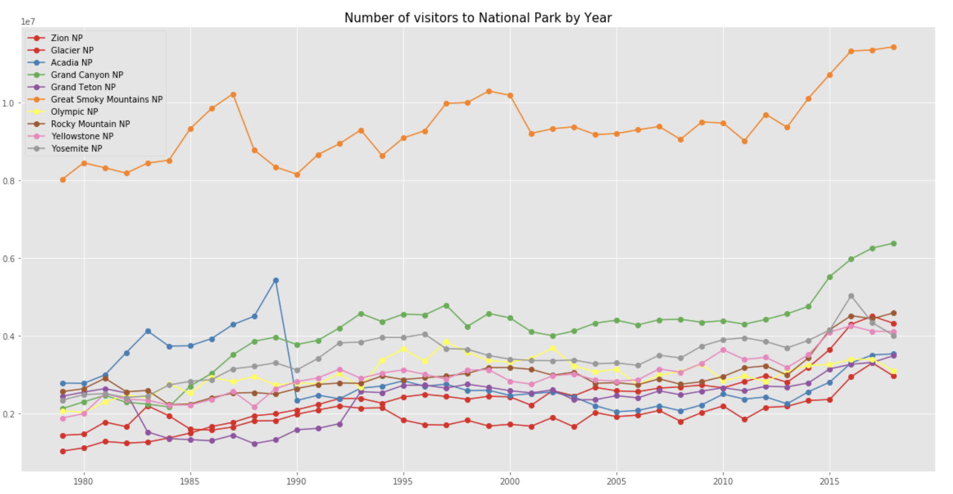
03
Analysis – Q1.
Where is Top10 National Park popular in the United States?
이 곳에 내용을 입력해주세요. 이 곳에 내용을 입력해주세요.

Slide 7
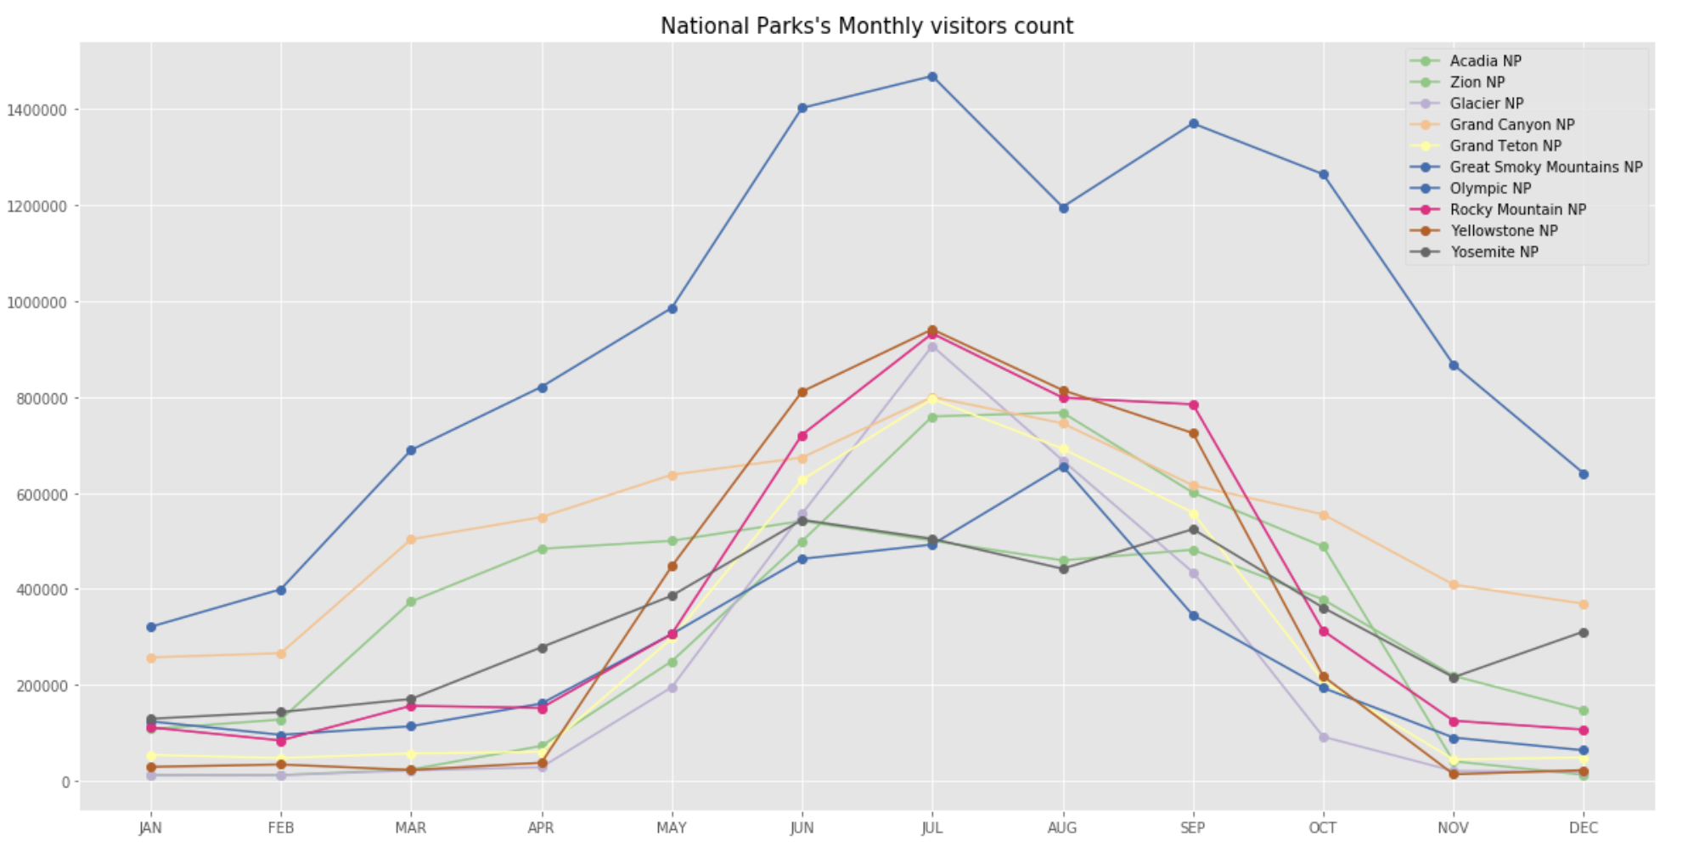
03
Analysis – Q2.
When is a good time to go to the national park?
이 곳에 내용을 입력해주세요. 이 곳에 내용을 입력해주세요.

Slide 8
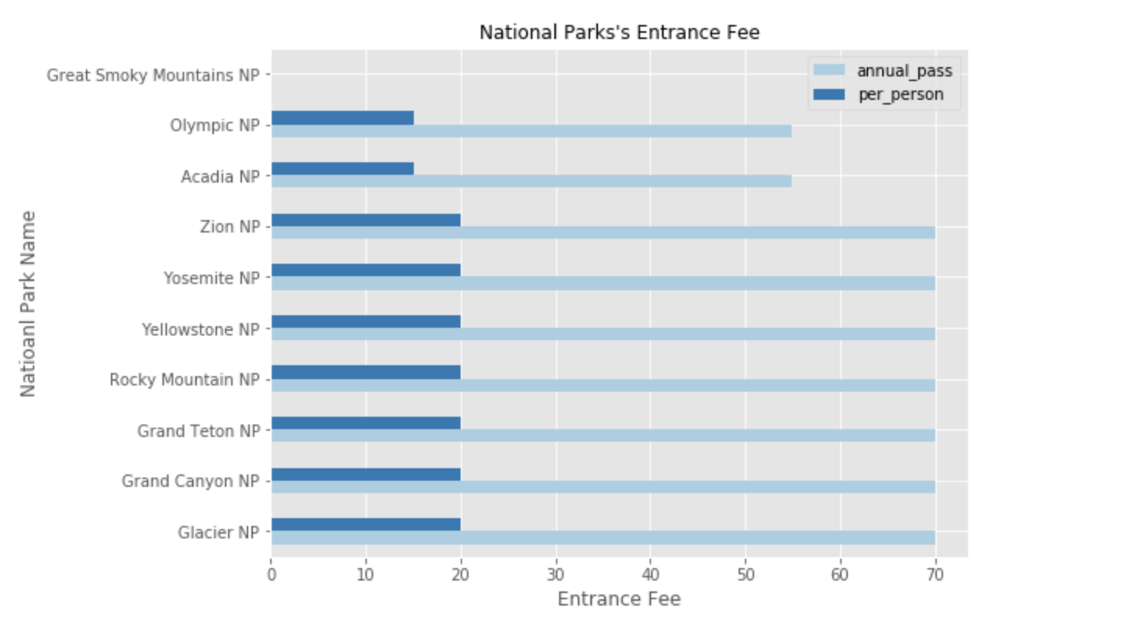
03
Analysis – Q3.
How much is the Entrance fee for a popular national park?

Slide 9
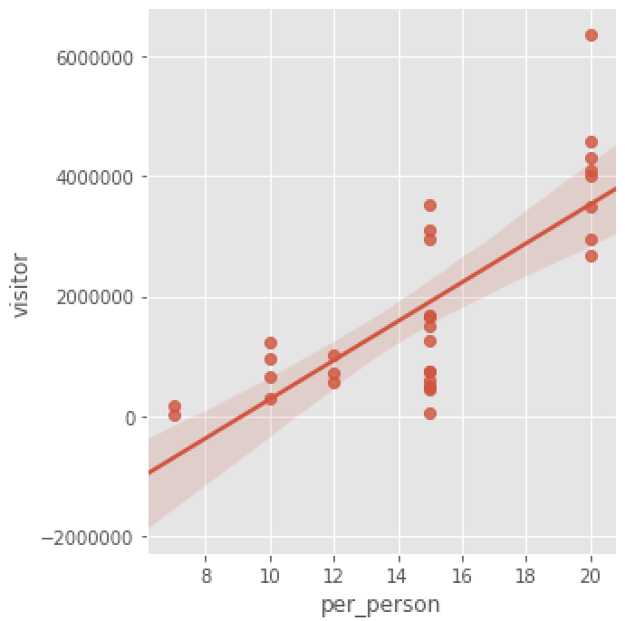
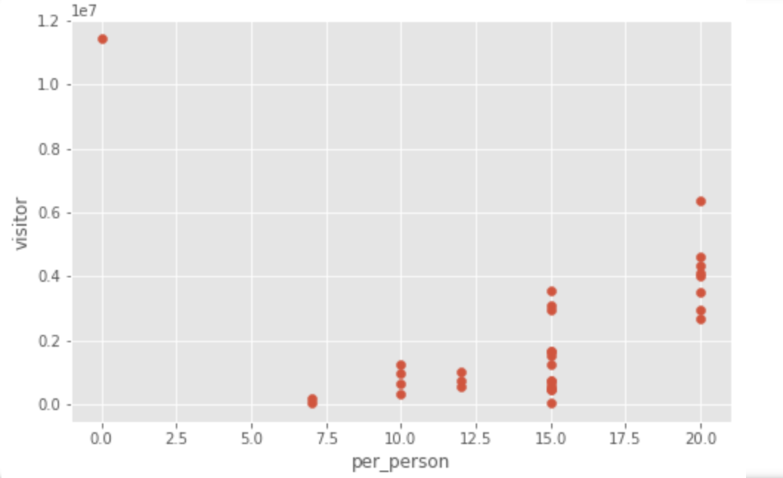
03
Analysis – Q3.
Does it have to do with the entrance fee and the number of visitors?
Great Smoky Mountain
Grand Canyon
Rocky Mountain

Slide 10


04
Summary & Future work
The number one visitor is Great Smoke Mountain, and except for this, the number of visitors has changed since the past.
Months with a large number of visitors are from June to September. If you prefer less crowded, it is good to go in May or October.
The Great Smokey Mountain is free of entrance fee and has the largest number of visitors. With the exception of Great Smokey Mountain, the high entrance fee shows that the number of visitors is high.
Correlation analysis of weather and number of visitors in national park
Analysis on the facilities and entrance fee of national parks

